Slide 1
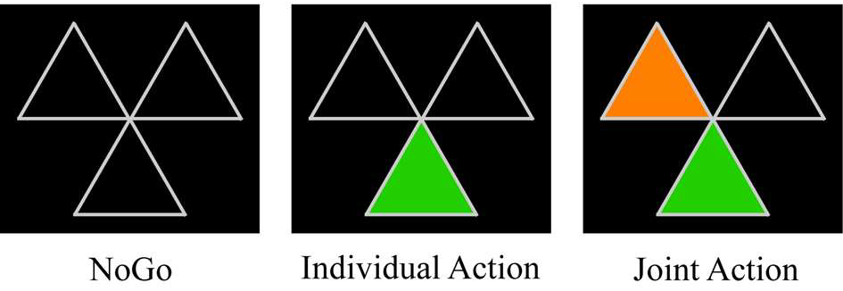
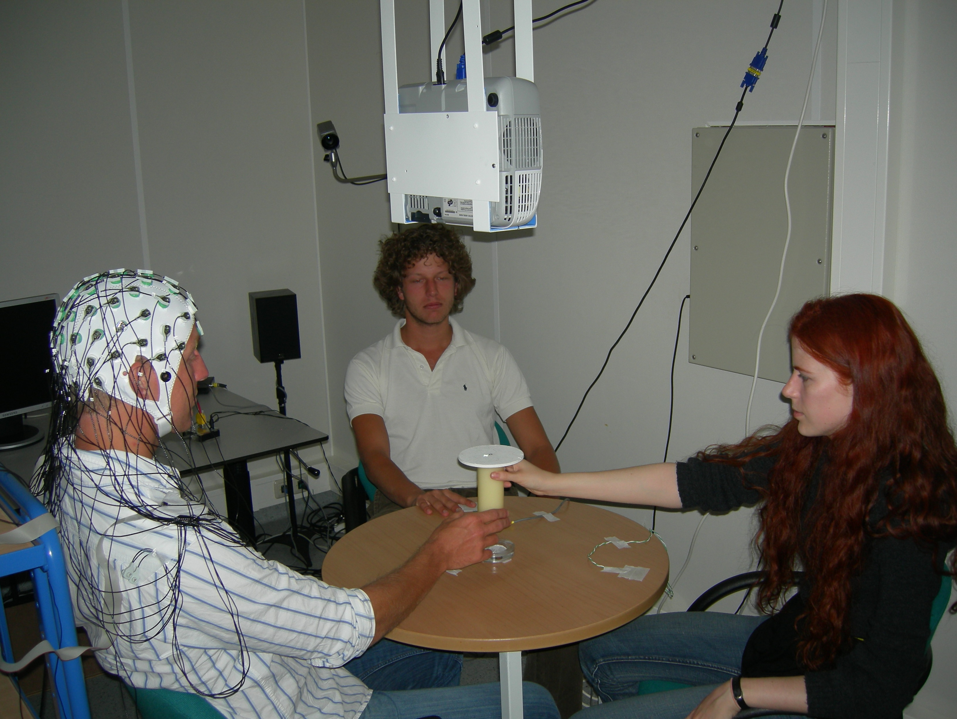

Joint Planning
Kourtis et al., subm.

Slide 2
Joint Planning
Kourtis et al., subm.

Slide 3
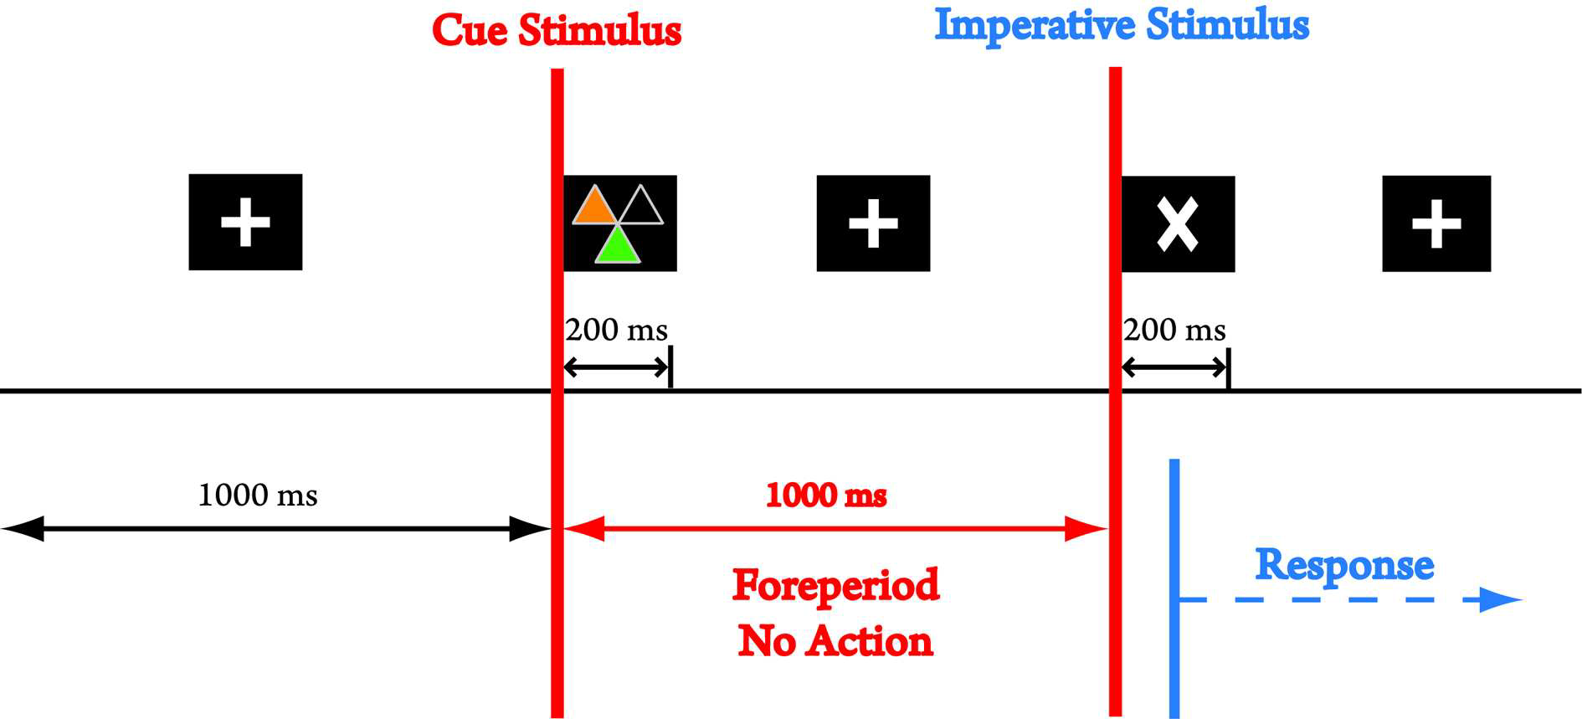
Joint Planning
Kourtis et al., in prep.

Slide 4
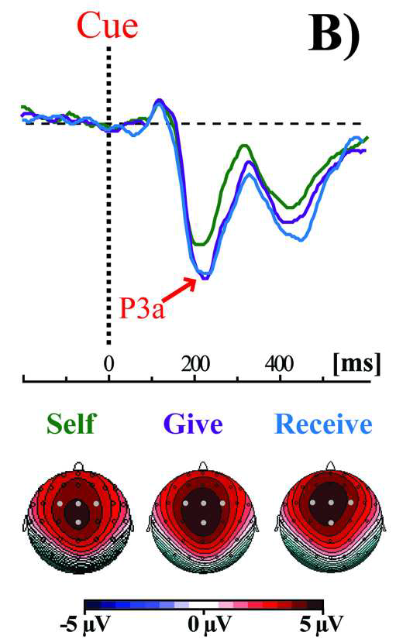
Joint Planning
Kourtis et al. subm.
The P3a amplitude is larger when participants prepare for joint action.
This likely reflects a more complex task representation, where the other’s part is specified in addition to one’s own.

Slide 5
Giving vs. Receiving
Kourtis et al., in prep.
Giving actions are initiated much faster than receiving actions.
If the CNV reflected just the preparation of one’s own action, it should peak much later in the receiver than in the giver.

Slide 6
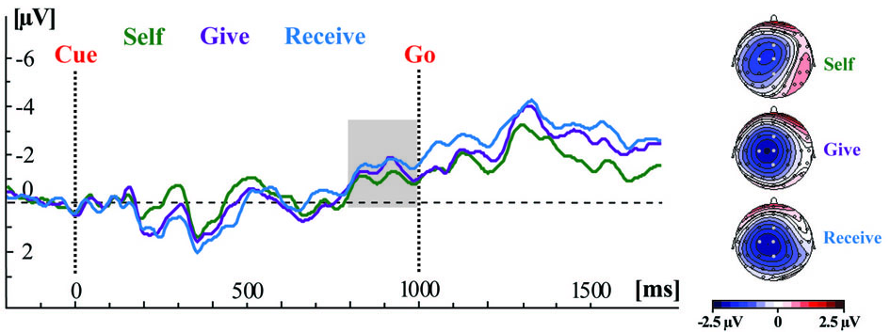
Predictive Action Simulation
The motor CNV in the receive condition peaked around the time of the partner’s response onset even though the receiver’s response onset occurred much later.

Slide 7
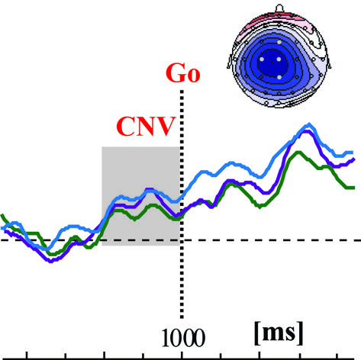
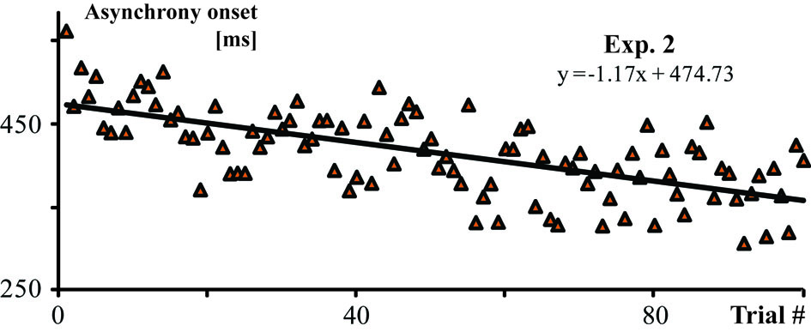
ERP/RT correlations when planning to receive the object
The amplitude of the motor CNV in the receiver was correlated with the improvement in coordination performance in a pair (r = 0.585, p = 0.022).

